Slide 1
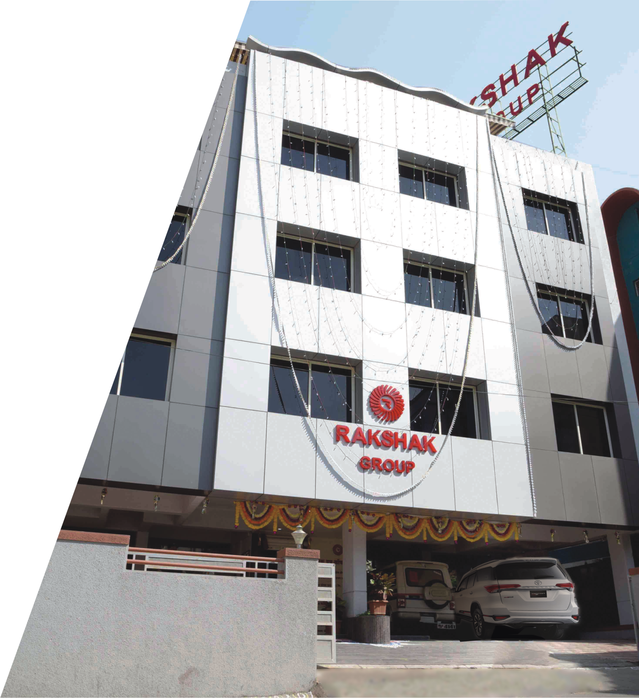

Slide 2
Company Profile
Rakshak Group (security services providing organisation) was founded by visionary Major Gajanan K. Patil, On 01/06/2005. On 22/09/2010, it was incorporated as Private Limited Company, named Rakshak Security Services Private Ltd. A company is proudly Pune based security solution company that serves across Pune and Maharashtra State. Rakshak Group of companies was started by visionary personnel Mr Ranjitsinh Patil to provide a high quality professional and cost effective security solution to the society. Rakshak group has 14 years of extensive knowledge and expertise in the Security and Industry.
As one of the industry’s leading Security Company Rakshak Security emphasis on quality combined with an innovative and customer focused approach to the provision of commercial focused approach to the provision of Commercial Security Services differentiates it from other organizations operating in the sector.
Based on the decision of the company to diversify our business we have now established in other activities with organizations as,
1) Rakshak Security Services and Systems Pvt Ltd
2) Rakshak Developers and Infra Pvt Ltd
3) Rakshak Fitness Centre
4) Rakshak Protection Force (Gunman, Bodyguard)
5) Rakshak Multispecialty Hospital
6) Gajakala Charitable Foundation

Slide 3
Scope of Work
Rakshak Group has grown from a family owned residential security firm to full spectrum offering a variety of services to residential, commercial and industrial customers alike. Rakshak group has successfully spread its roots and proved its excellence in different businesses like Rakshak Security Force offering security personnel for many government, semi government, education, manufacturing plants, corporate offices and housing societies. Rakshak Fitness Centre Gym, Body building and yoga centre. Gajakala Charitable Trust was founded in the year 2010. The trust manifesto was to help poor and downtrodden children of the society, by adopting them and providing with basic necessities like food, clothing, shelter and education. Thus a small beginning in the year 2005 has now been transformed into a strong enterprise that provides shelter and nourishment to lives of many people.
Rakshak Infotech Pvt Ltd Established in 2015. Having an experienced team of software developers who are extremely motivated professionals committed to develop applications as well as provide maintenance for start-ups as well as big enterprises. We also provide mobile application development services.

Slide 4
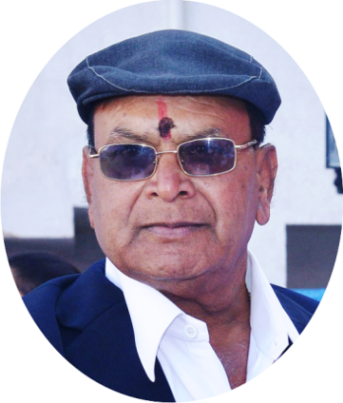
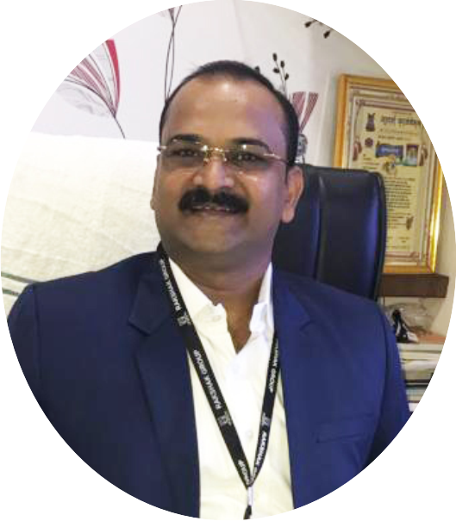
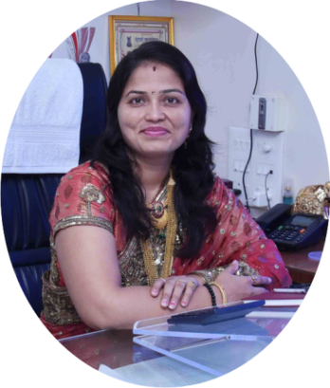
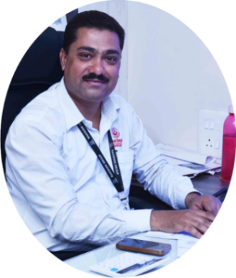
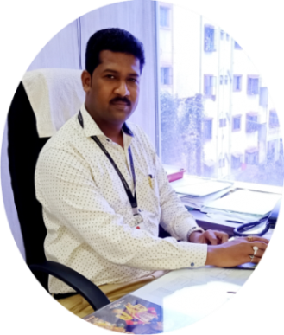
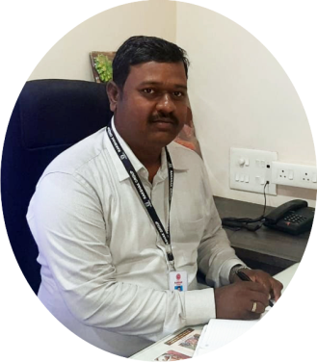
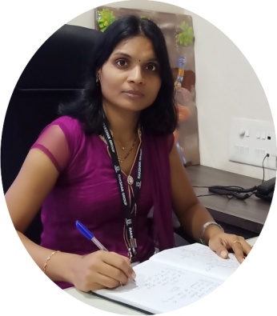
Meet Our Team
Major Gajanan Keshav Patil
Mr. Ranjitsinh Gajanan Patil
Mrs. Sunita Ranjitsinh Patil
Founder
MD
Director
Mr. Sambhaji Ingavale
Mr. Nitin Deshmukh
Mr. Sahadeo Waghmare
Mrs. Ulka
Hulsure
HR Manager
Admin Manager
Operation Manager
CRM

Slide 5
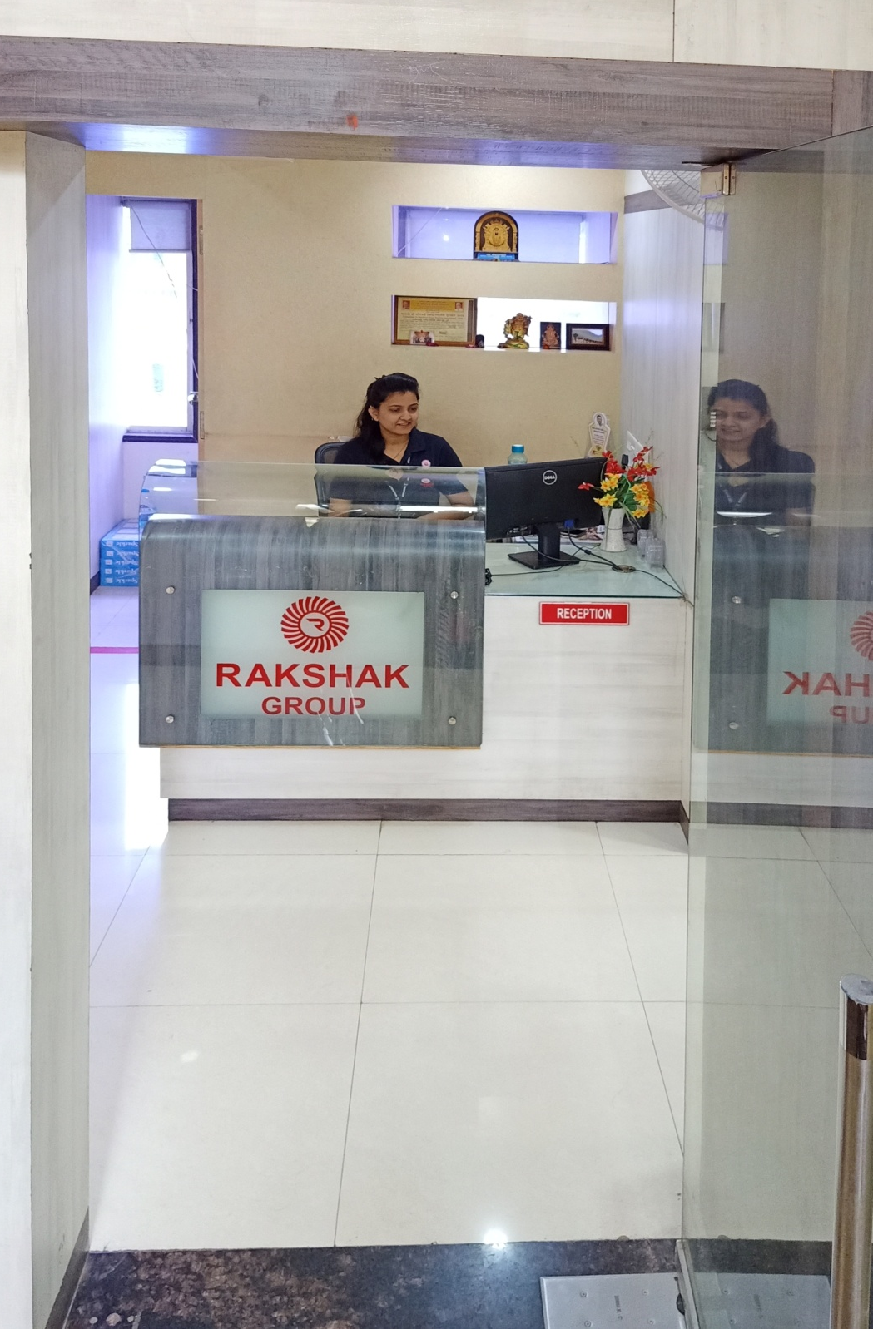
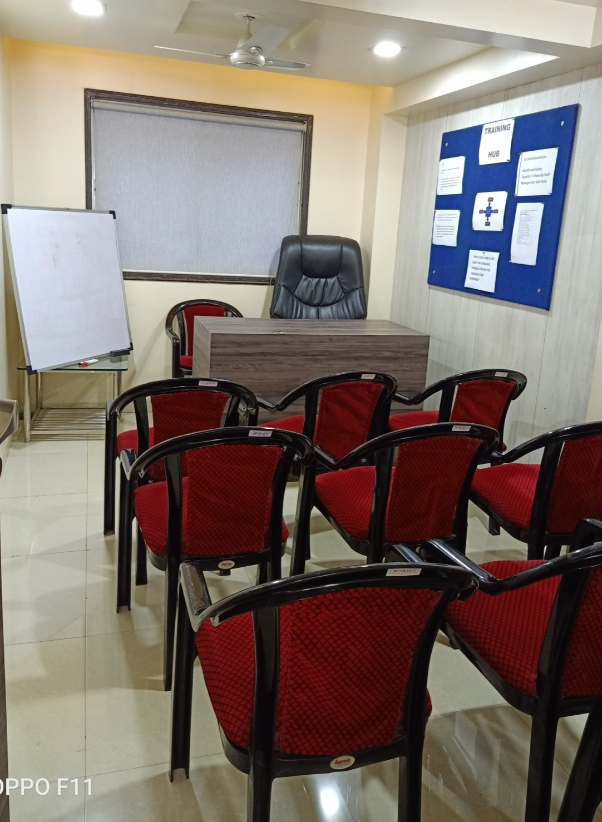
Front Office
Training Room
Front Office of Corporate office
Training Room

Slide 6
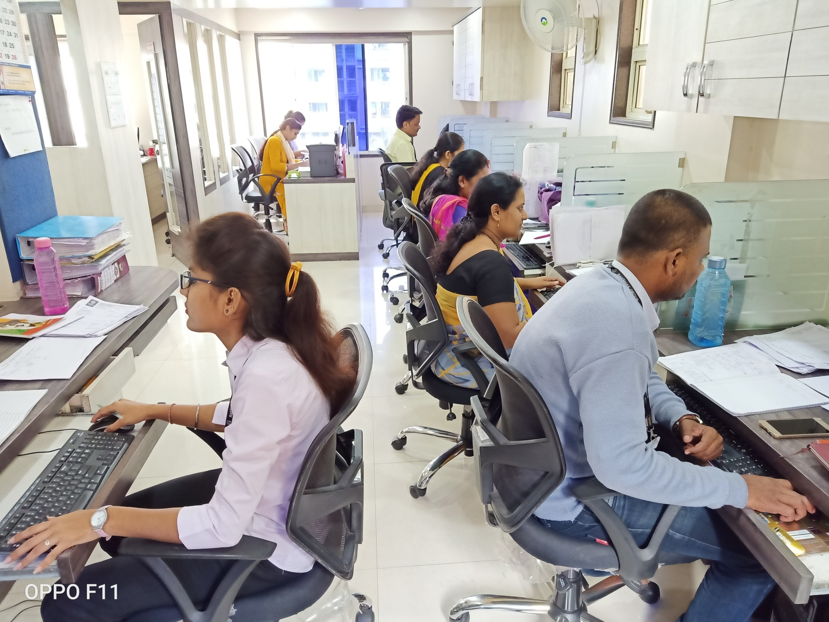
Office Staff
Office Staff

Slide 7
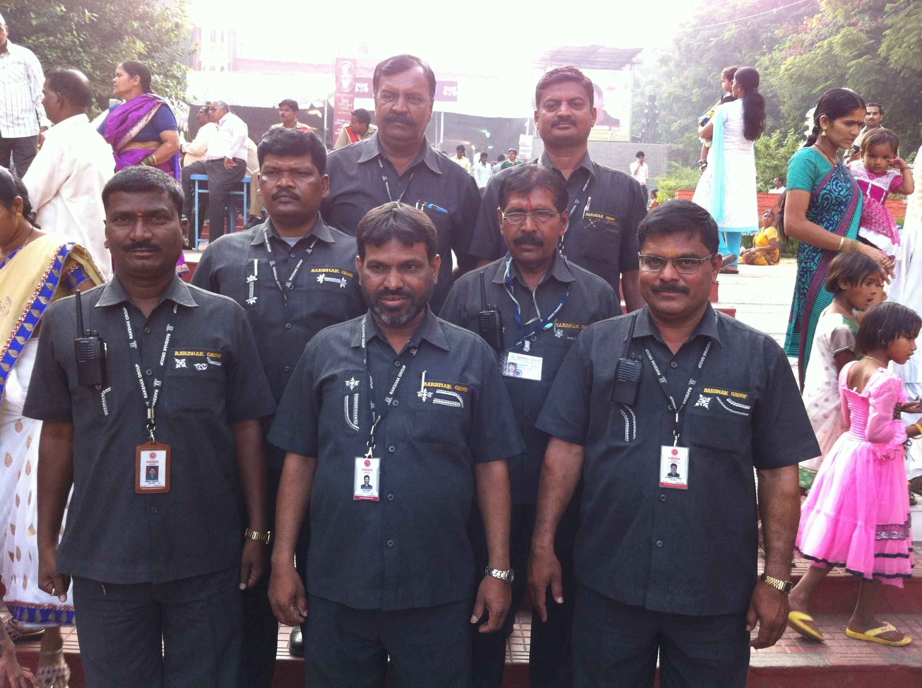
Field Officers
Field Officers

Slide 8
Our Vision
To gain customer trust and to set bench mark in the industry by competitive business building with standard in security service.

Slide 9
Our Mission
To provide various security services to clients as per their requirement.
To provide protection to lives, properties with quality services and customer satisfaction.
To provide protection from emergency, fire and disaster.
To improve overall quality and performance of security services through training and new technology.
By conducting safety audit to pinpoint risk and threat to provide disaster control damage.

Slide 10
Our Values
• Respect : Treat all clients with dignity and respect
• Integrity : Always Honest, Loyal & Ethical in words and action.
• Quality : We believe in quality & deliver the same with professional Conduct.
• Innovation : New Ideas and Innovative creation

Slide 11
OUR SPECIALITIES
• We are the leading security services provider in Pune and Maharashtra. Having years of experience we are engrossed in growing satisfied customers.
• We are specialists in providing quality services and have team of well trained professionals with fantastic attitude towards our clients.
• Our guards are fully qualified and trained to tackle with every situation to provide protection for lives and properties.
• We hire only professional security guards who have ample knowledge and experience within security field.

Slide 12
OUR SERVICES
Rakshak Security services and Systems Pvt Ltd is the best security services in Maharashtra, provide security services in various establishments like Corporate Offices, commercial establishments, Banks, Government and Semi Government Offices.

Slide 13
From Our Photo Gallary

Slide 14
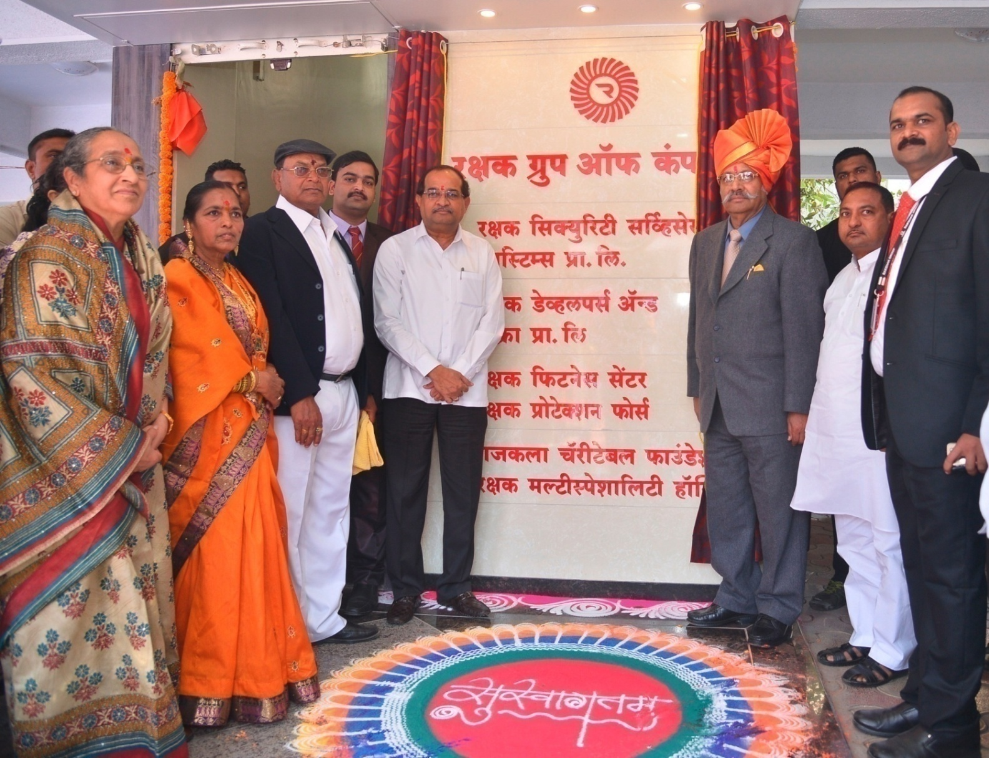
Opening of Corporate Office
Inauguration of our Corporate office

Slide 15
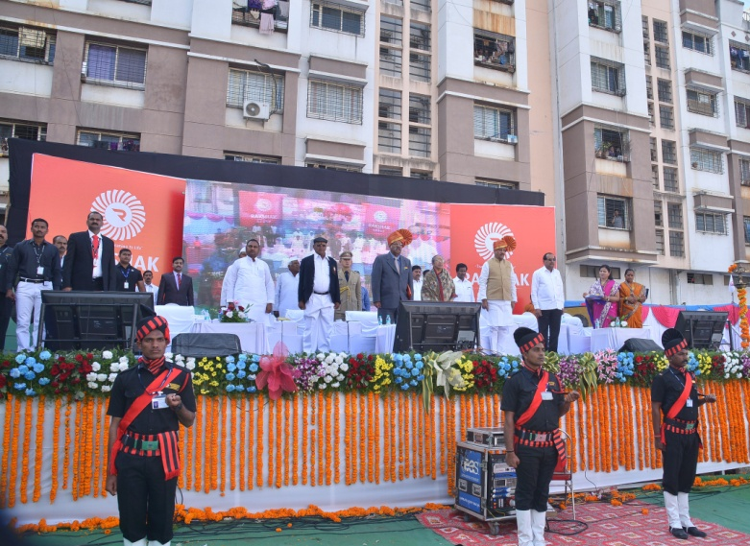
In presence of Radhakrishna Vikhe Patil (Opposition Leader), Mr Shriniwas Patil (Sikkim Governor), Mr Prithviraj Chavan (Ex. Chief Minister), Sindhutai Sakpal (Social Worker)
Grand Inauguration Ceremony
In presence of Radhakrishna Vikhe Patil (Opposition Leader), Mr Shriniwas Patil (Sikkim Governor), Mr Prithviraj Chavan (Ex. Chief Minister), Sindhutai Sakpal (Social Worker)

Slide 16
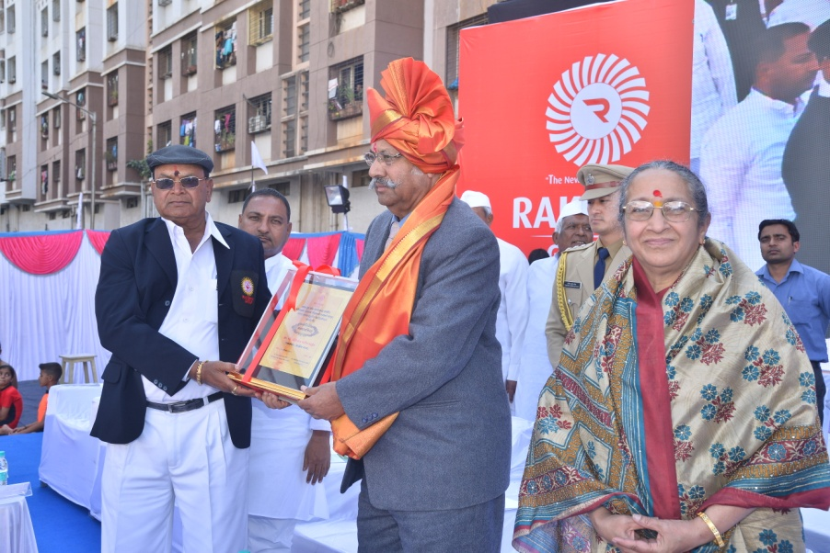
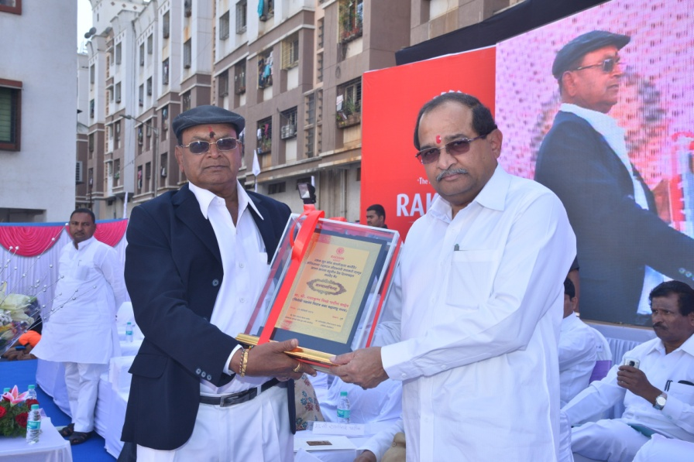
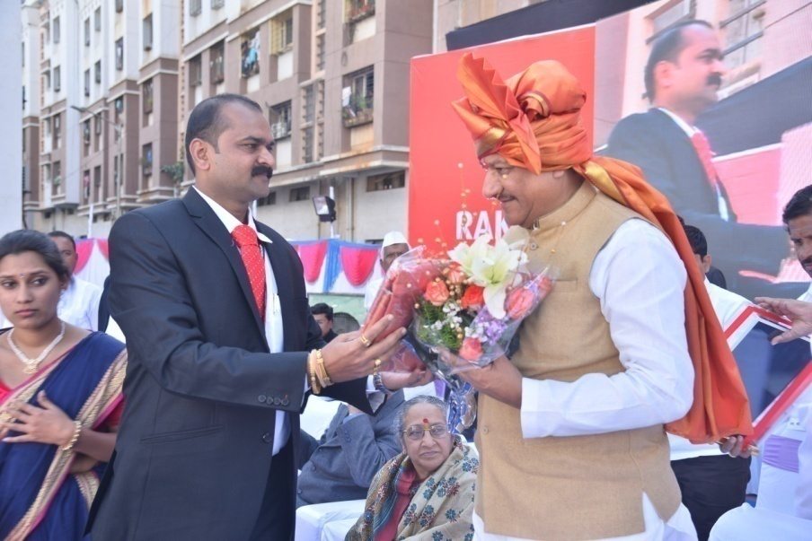
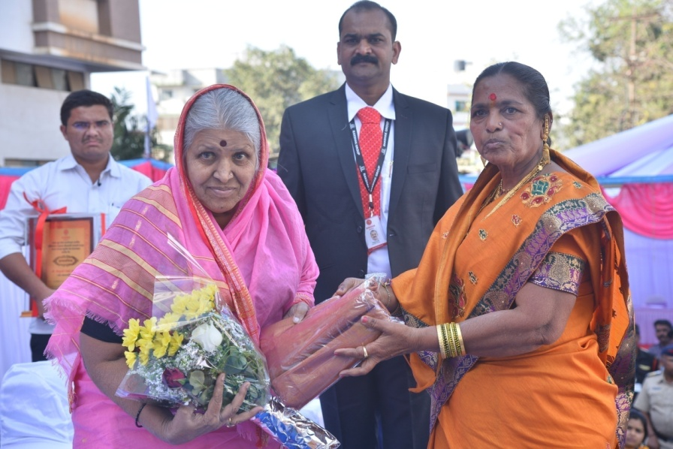
Celebrating the inauguration
Major Gajanan Patil (Founder) Presenting momento to Mr Shriniwas Patil (Sikkim Governor) as vote of thanks
Major Patil Sir Presenting momento to Mr Radhakrishna Vikhe Patil (Opposition Leader) as vote of thanks
Mr Ranjitsinh Patill, MD Offering Flower Bouguet to Mr Prithviraj Chavan (Ex. Chief Minister) as vote of thanks
Great moment with Great Social Worker – Sindhutai Sakpal

Slide 17
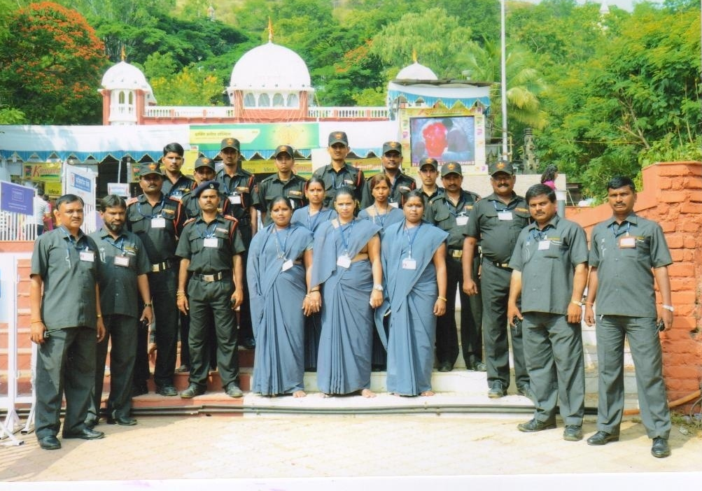
Security Guard Team at Chaturshrungi Mandir
Security Guards Team at Chaturshrungi Mandir, Pune

Slide 18
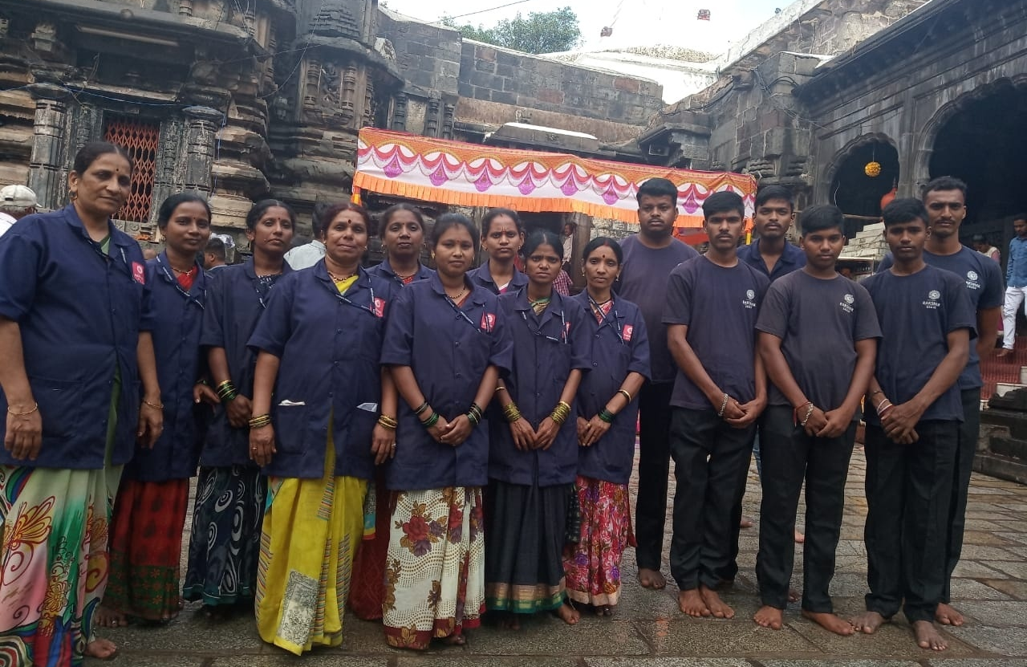
House keeping Team at Mahalakshmi Mandir
House keeping Team at Mahalakshmi Mandir

Slide 19
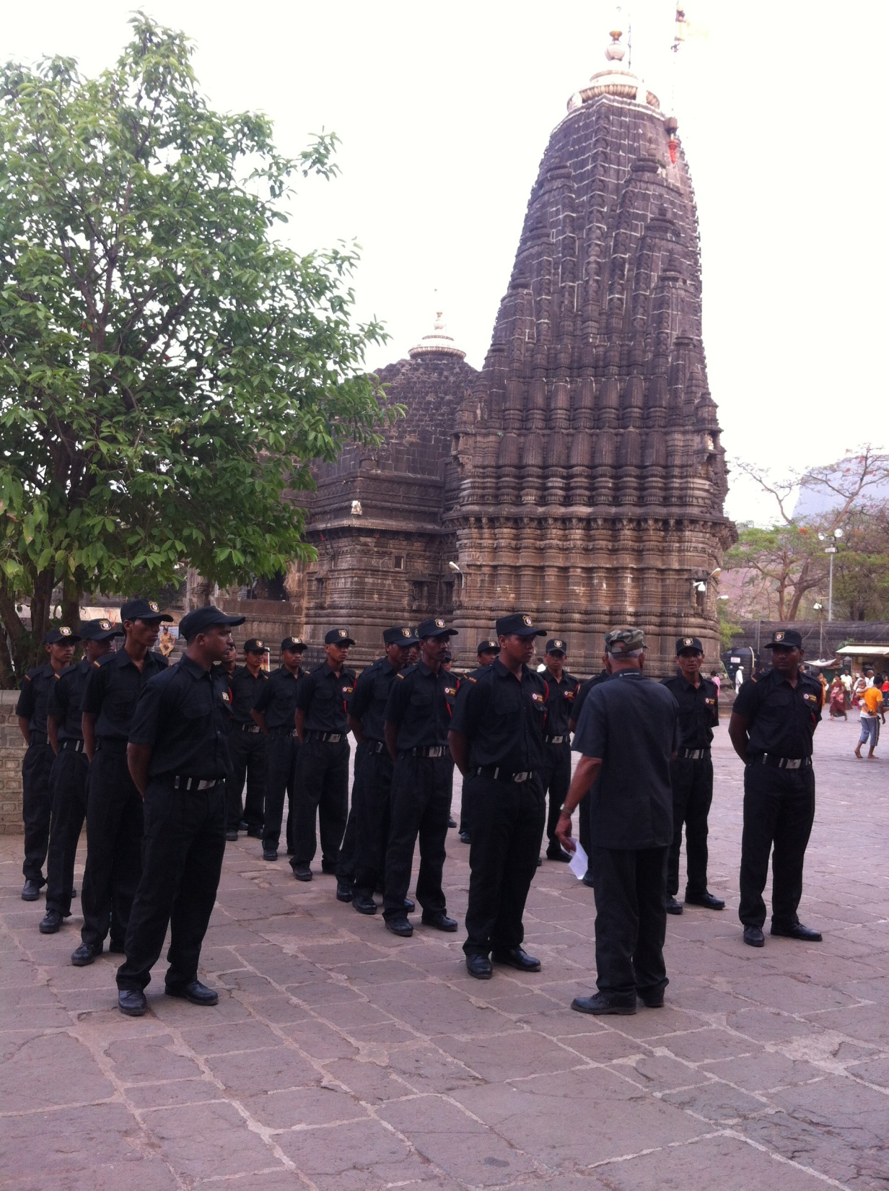
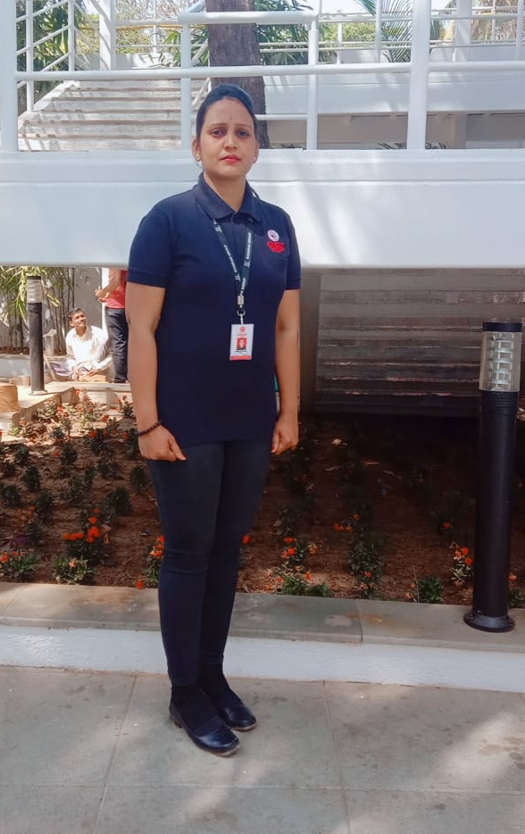
Guards Training
Lady Bouncers
Guards Training
Lady Bouncers

Slide 20
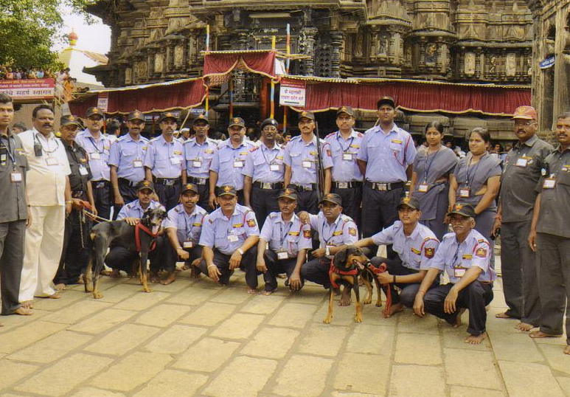
Security Guards & Dog Squad at Mahalakshmi Mandir, kolhapur

Slide 21
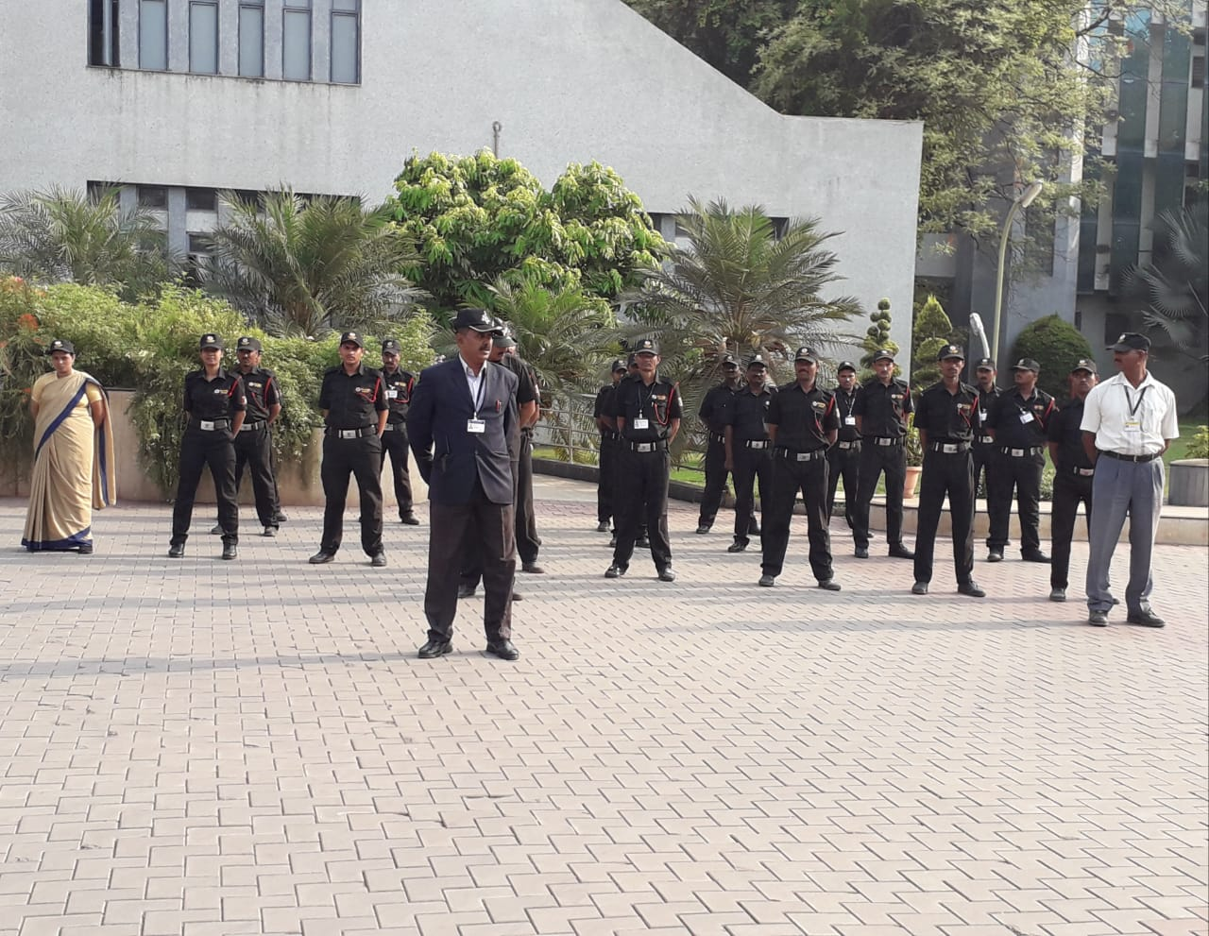
Team at Bharati Hospital, Sangli
Team at Bharati Hospital Sangli

Slide 22
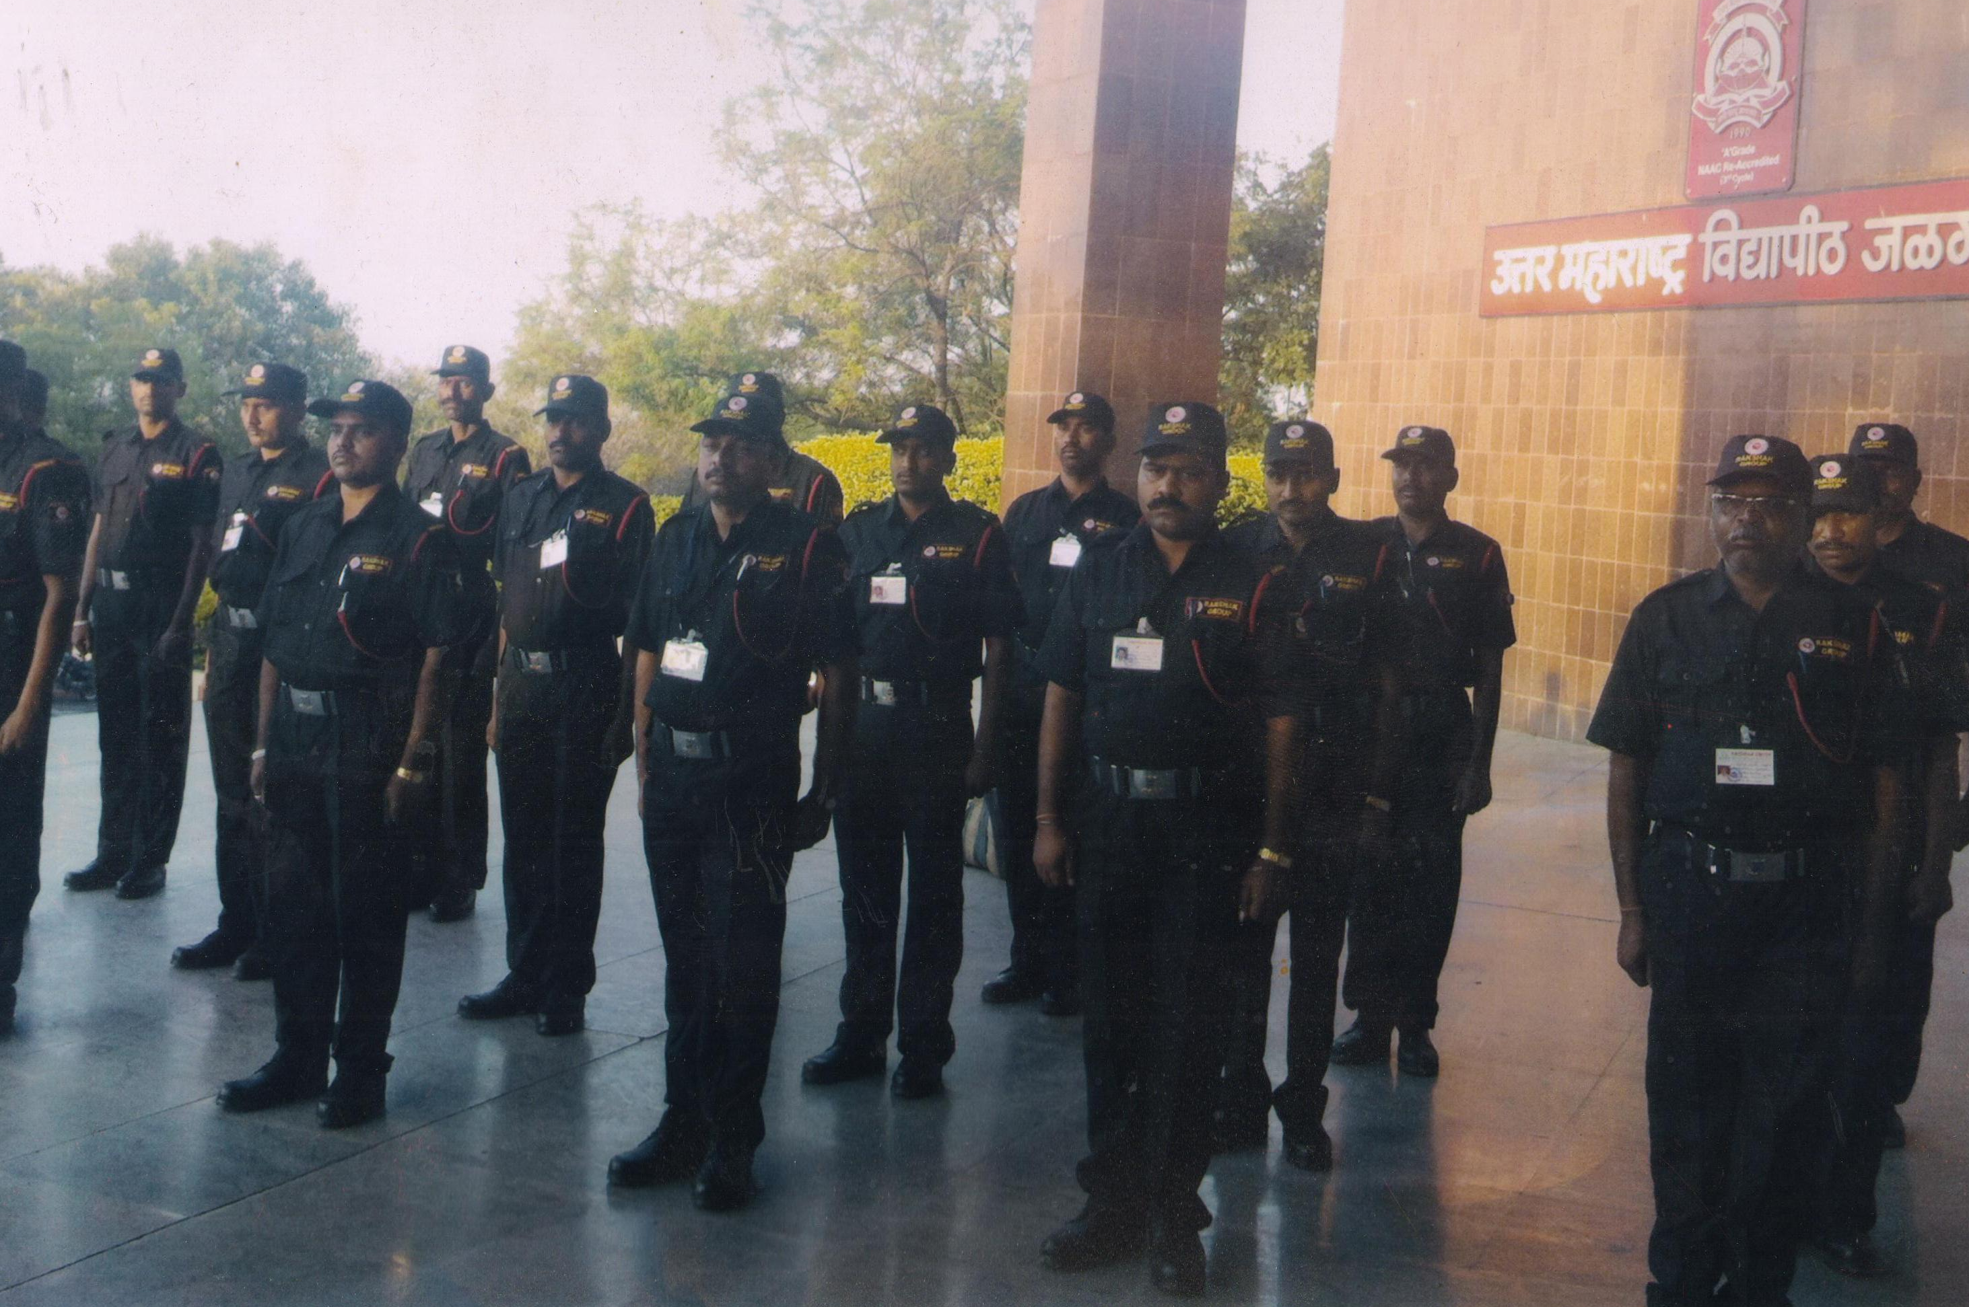
Team at Jalgaon Vidyapeeth

Slide 23
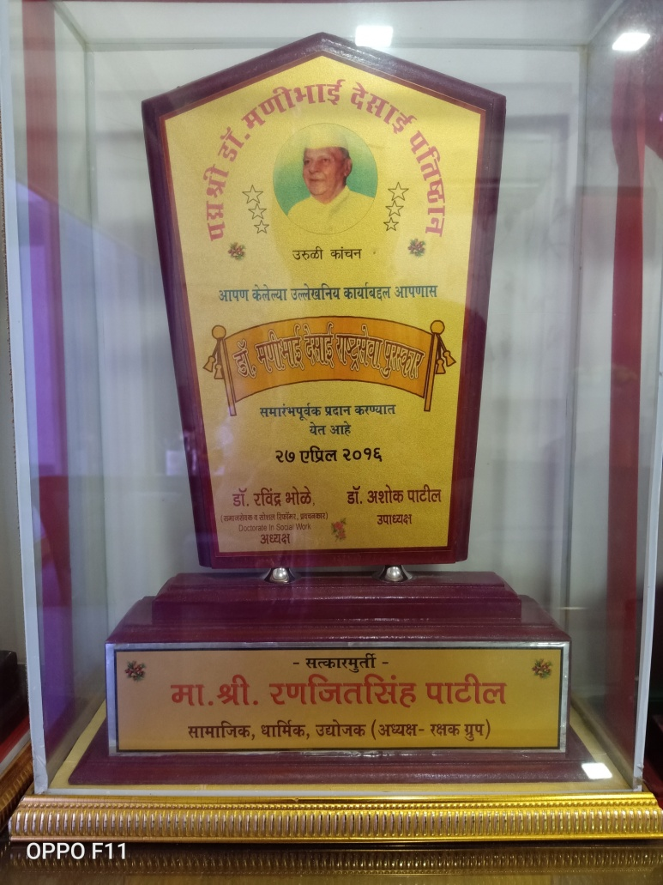
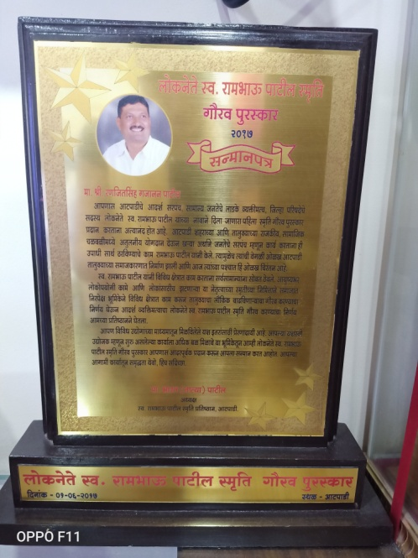
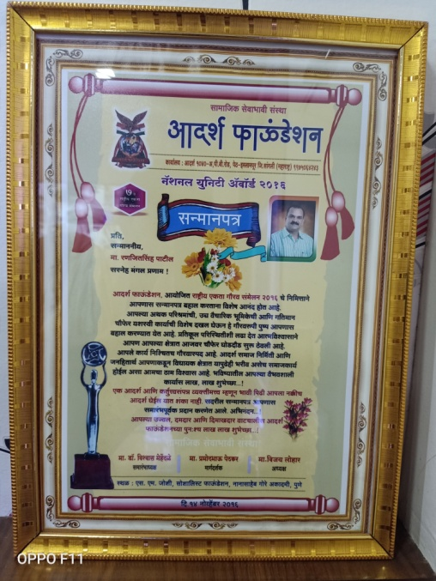
Glorious Honour by various Organizations

Slide 24
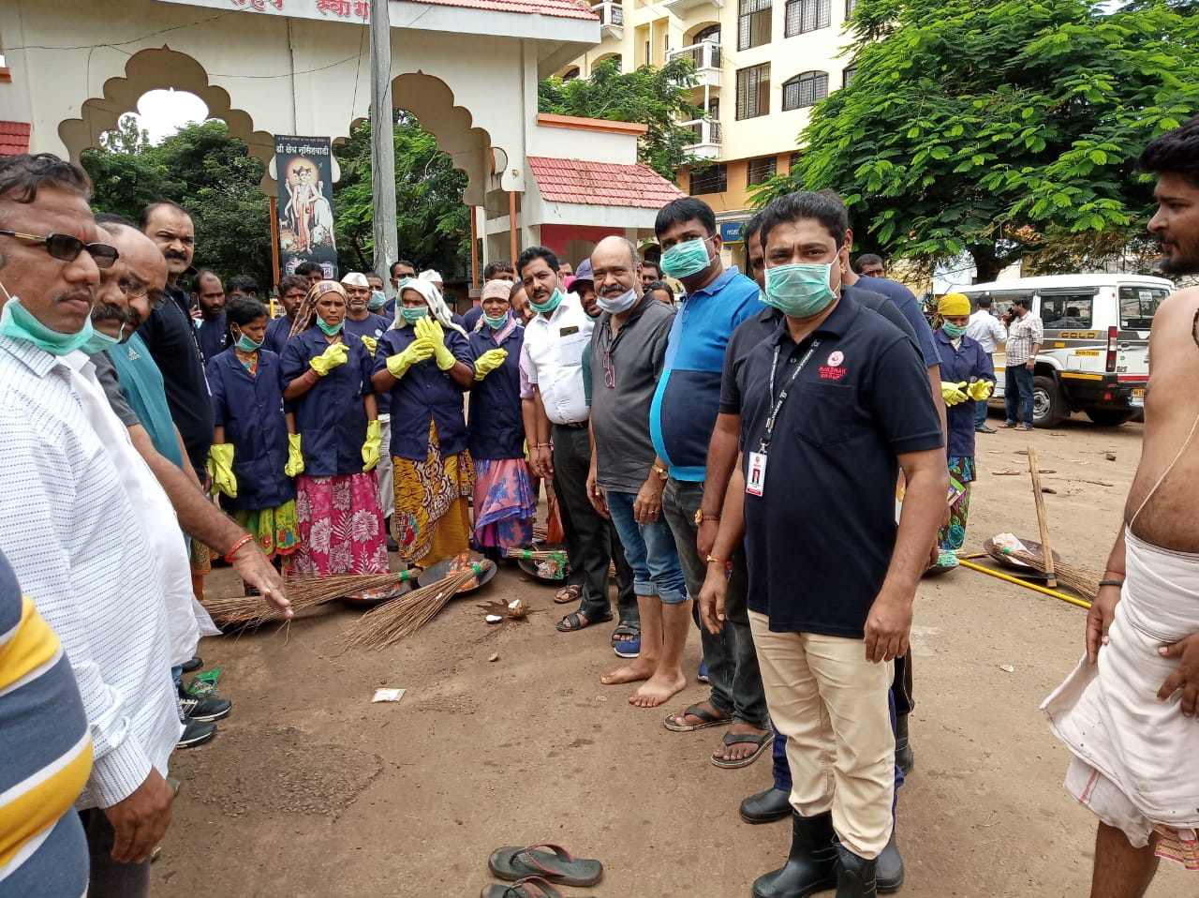
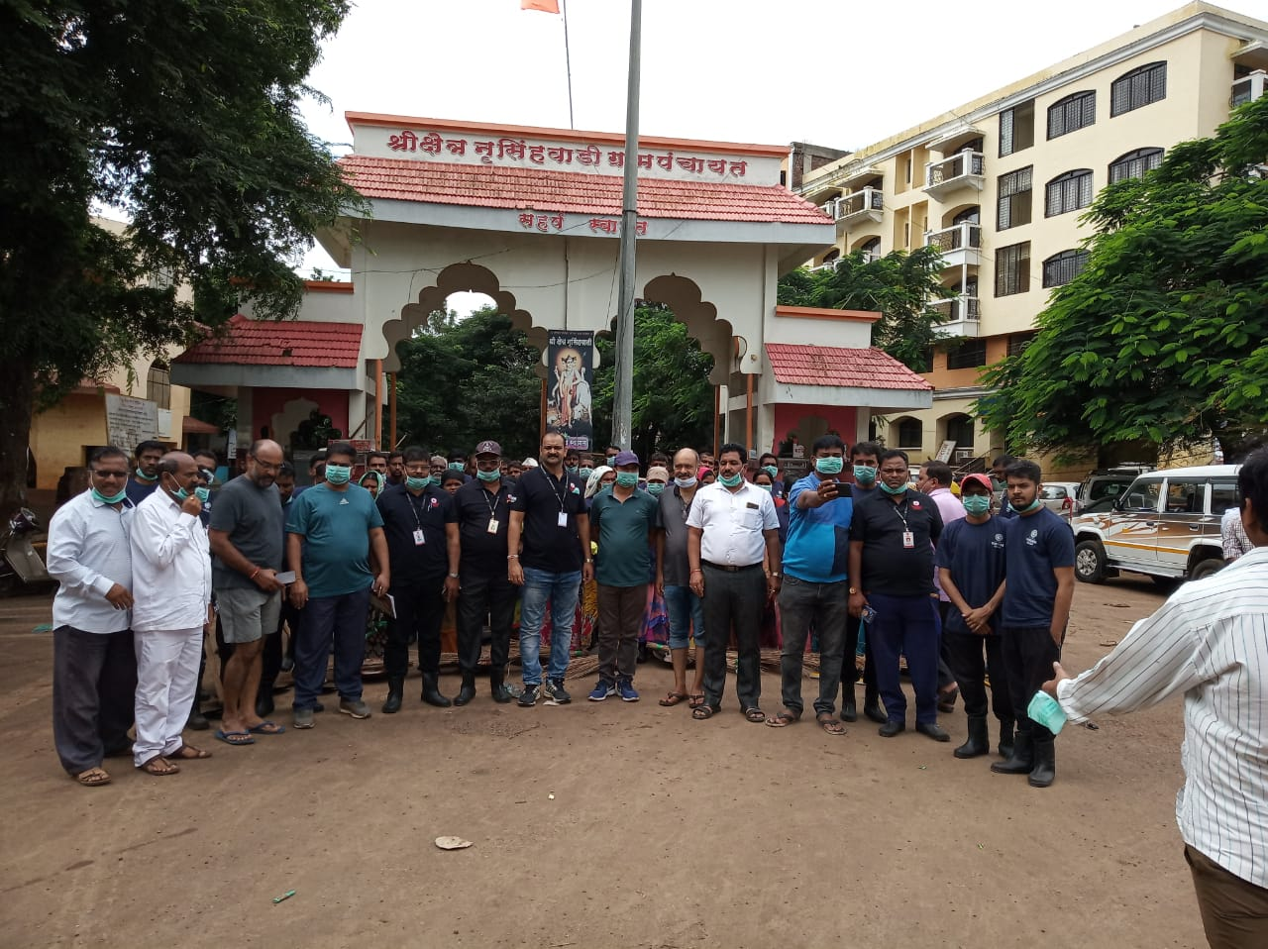
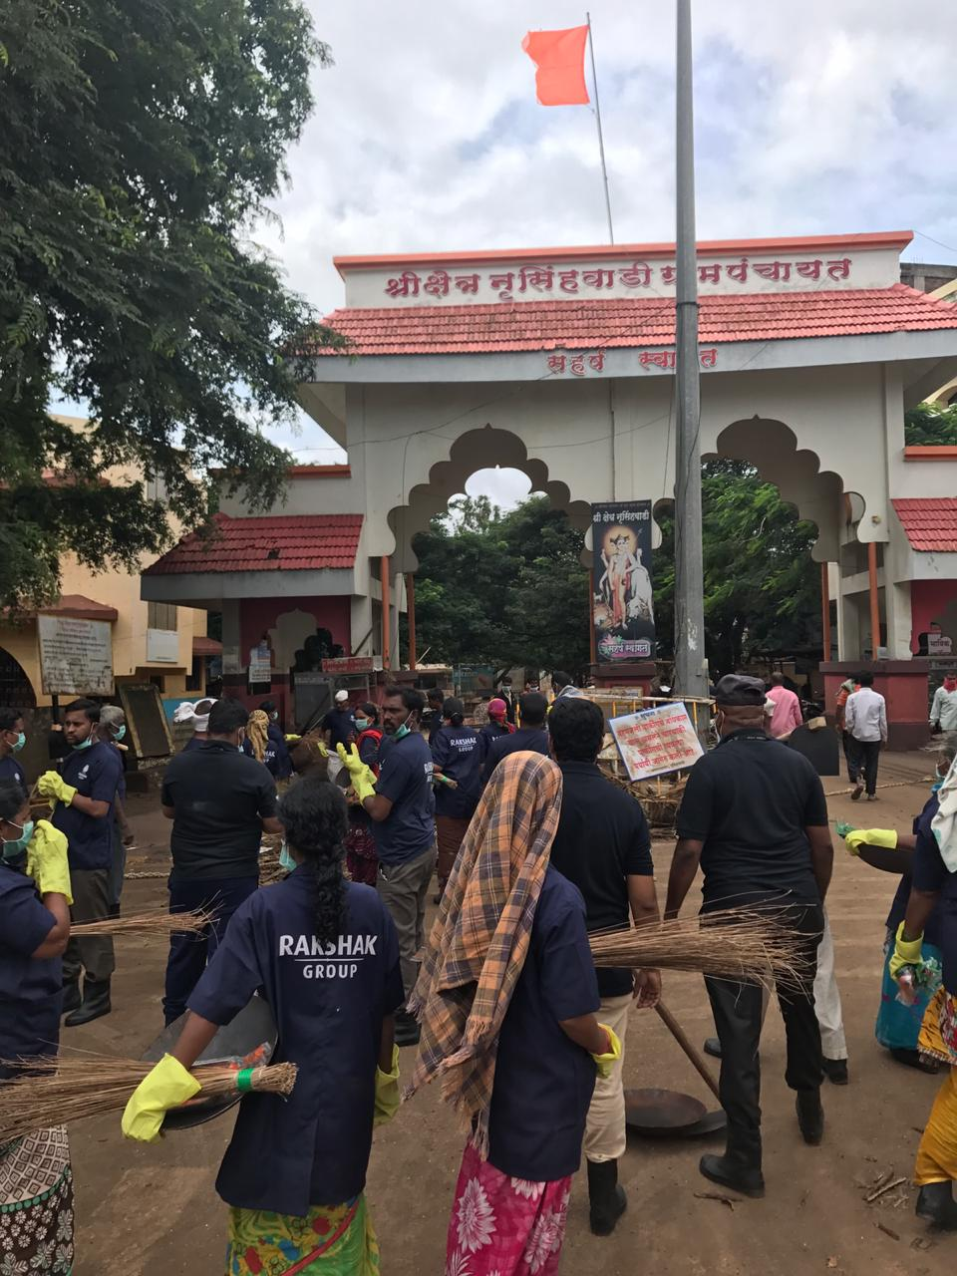
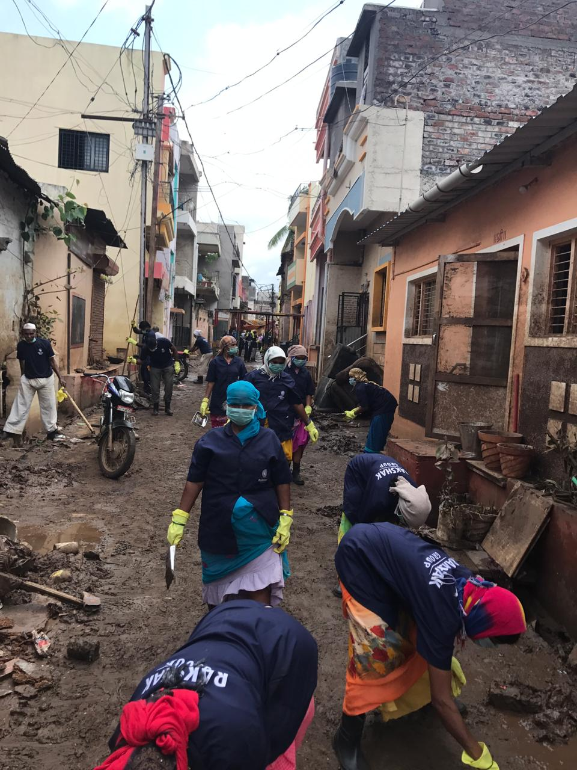
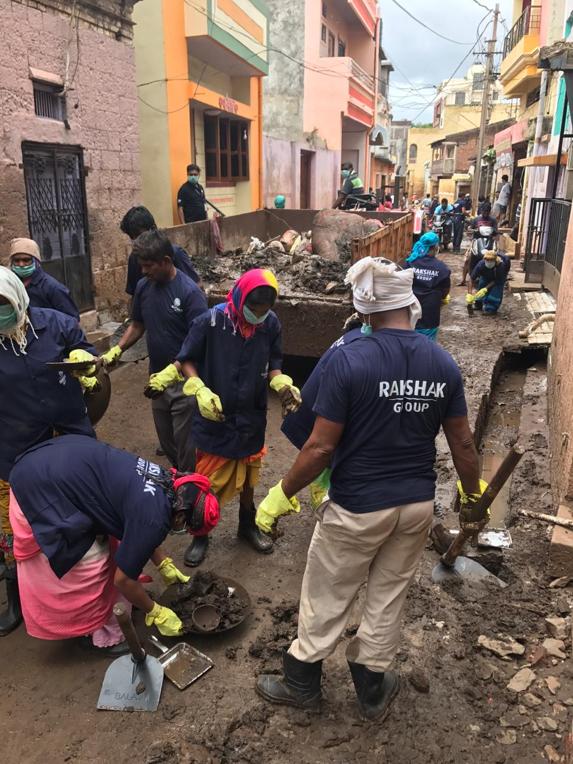
Social Awareness
Our Team in action at the time of unfortunate flood in Maharashtra

Slide 25
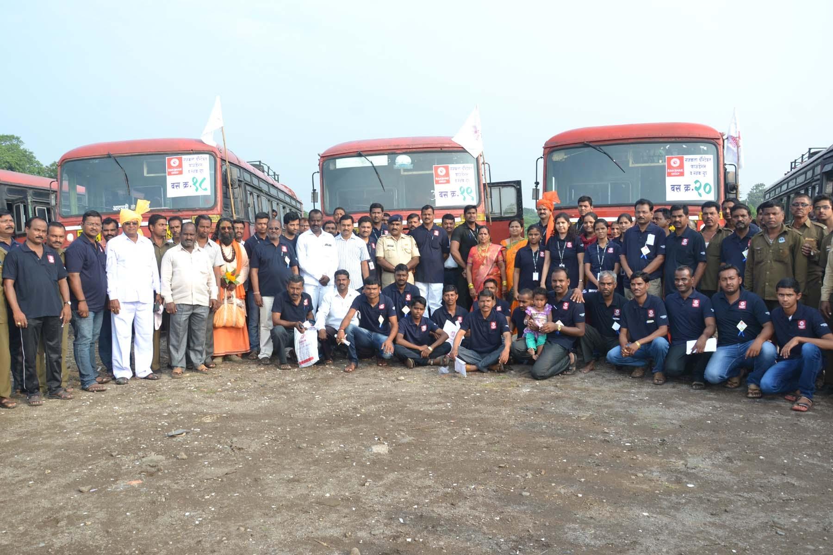
Arranged 40 buses for Mahalaxmi Darshan at Kolhapur from Atpadi Gav
on the occasion of Navaratri

Slide 26
Presence in social Media
Presence in Social Media

Slide 27
Our Registration Nos.:
Sr. No. | Particulars | Details
1 | COMPANY REG.NO. | U74920PN2010PTC 137400
2 | SHOP ACT NO. | 1931000312951418
3 | PAN CARD NO. | AAECR9729C
4 | GST IN NO. | 27AAECR9729C1Z7
5 | PF NO. | MH/PUN/09/305414
6 | ESI NO. | 33000424000001018
7 | PROFFESSIONAL TAX NO. | 27785236161
8 | TAN NO. | PNER 12105C
9 | POLICE PARWANA | 7190
10 | ISO 9001:2008 CERTIFIED COMPANY ISO 45001 : 2018 CERTIFIED COMPANY | Yes

Slide 28
List Of Branches:
Sr.No | Branch | Total no. Of Employees | Managerial Personals
1 | Pune | 2234 | 30
2 | Ahmadnagar | 912 | 7
3 | Sangli | 80 | 3
4 | Kolhapur | 350 | 5
5 | Dhule- Nandurbar | 400 | 4
6 | Nashik | 120 | 2
7 | Shirdi | 700 | 5
8 | Chakan | 30 | 1

Slide 29
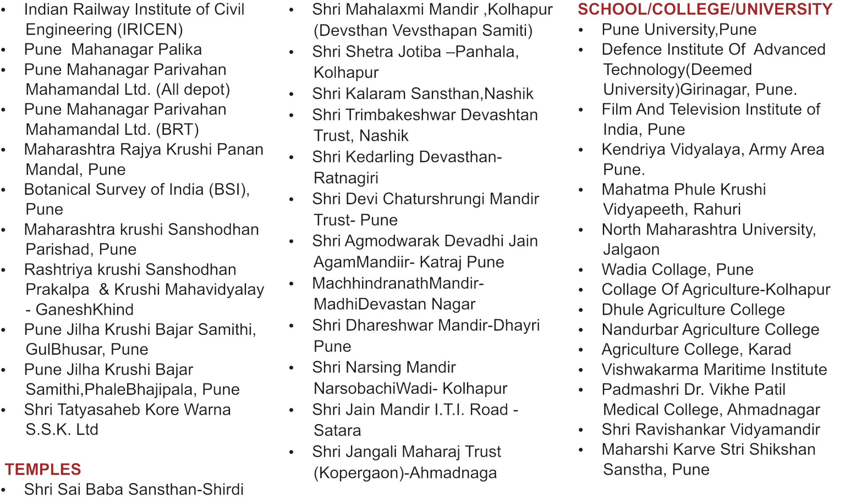
Present and Past Clientel List
Central, State & Semi Government Organsations

Slide 31
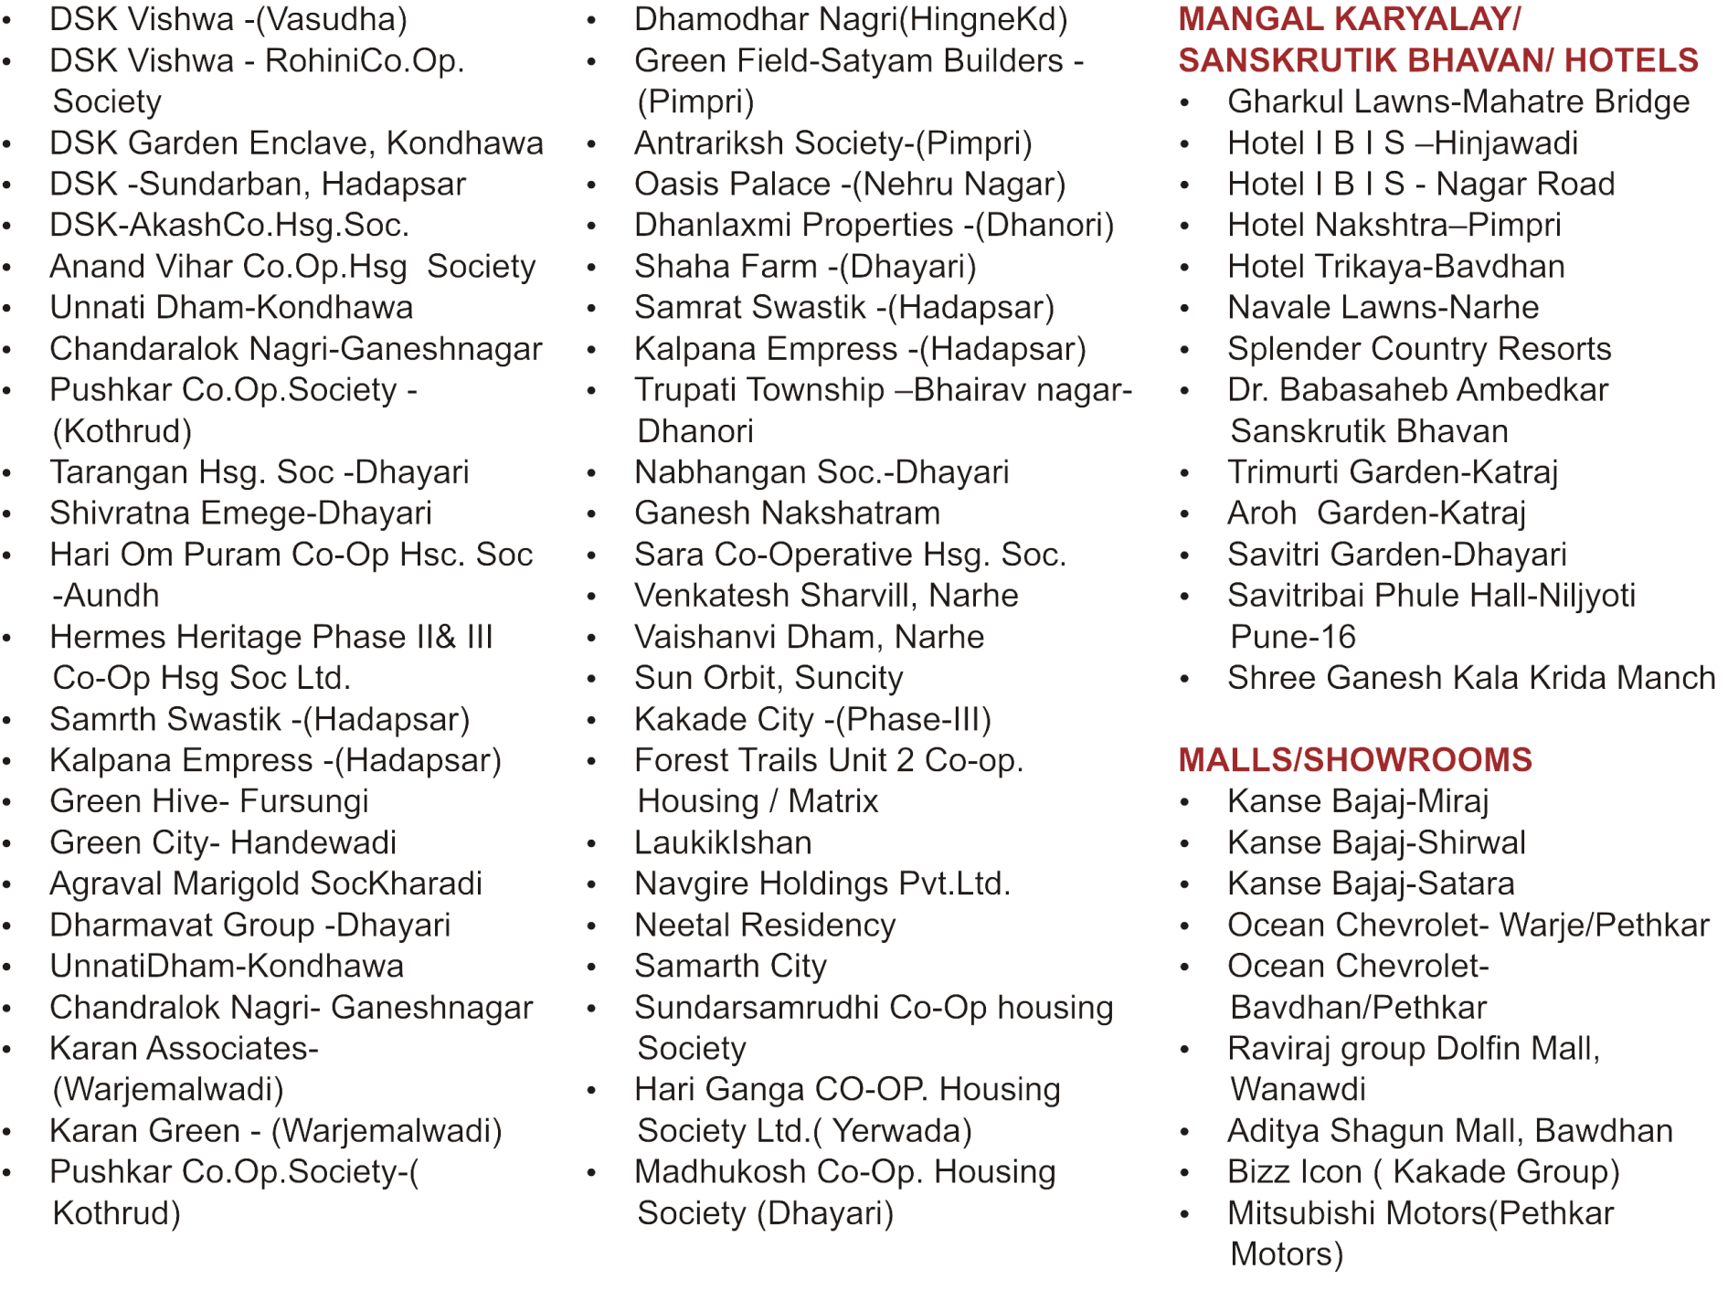

Slide 32
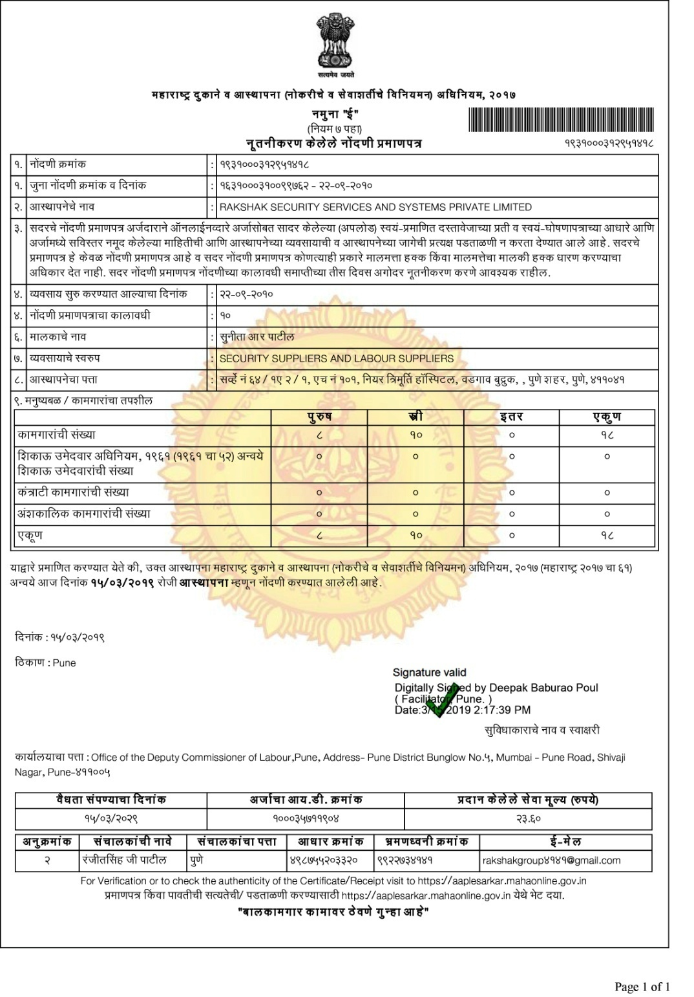
Shop Act License

Slide 33
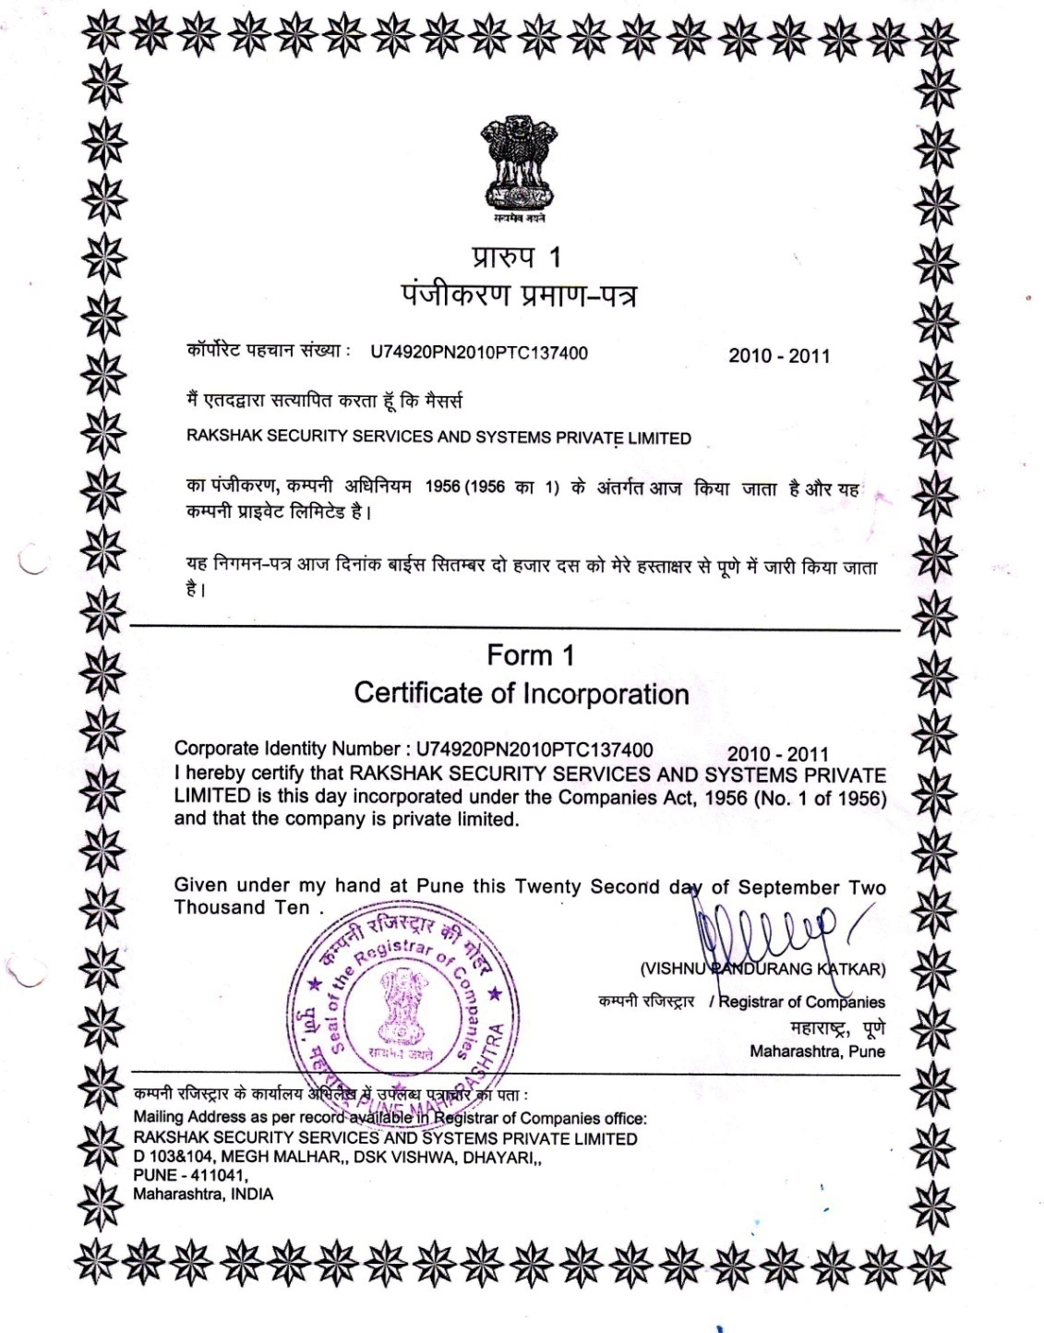
Company Incorporation

Slide 34
PAN CARD

Slide 35
ISO Certificate

Slide 36
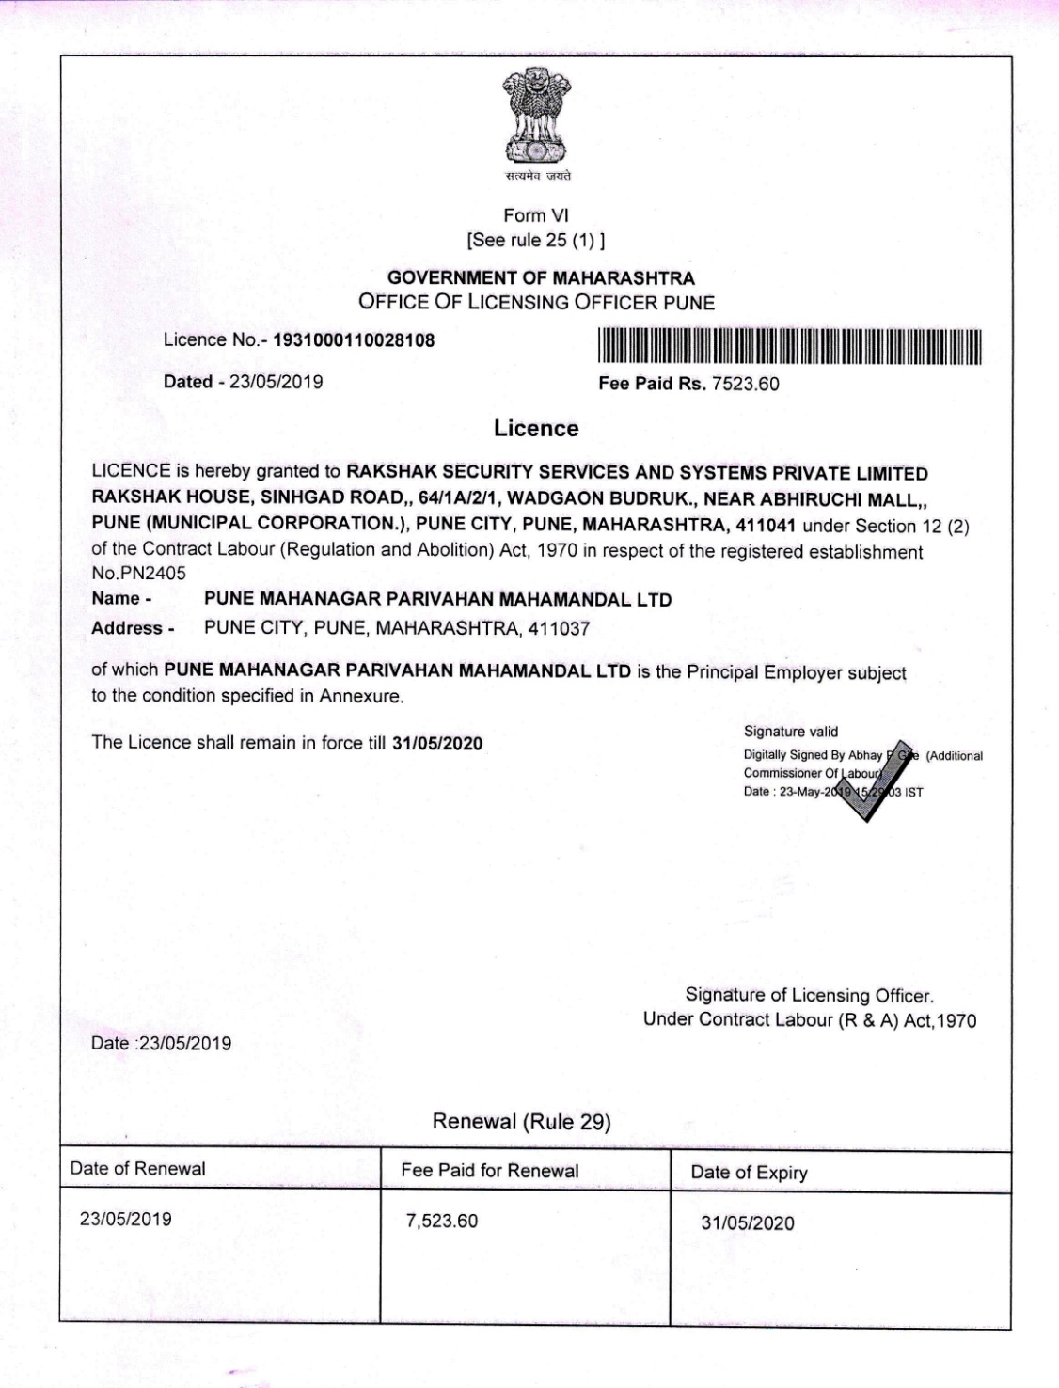
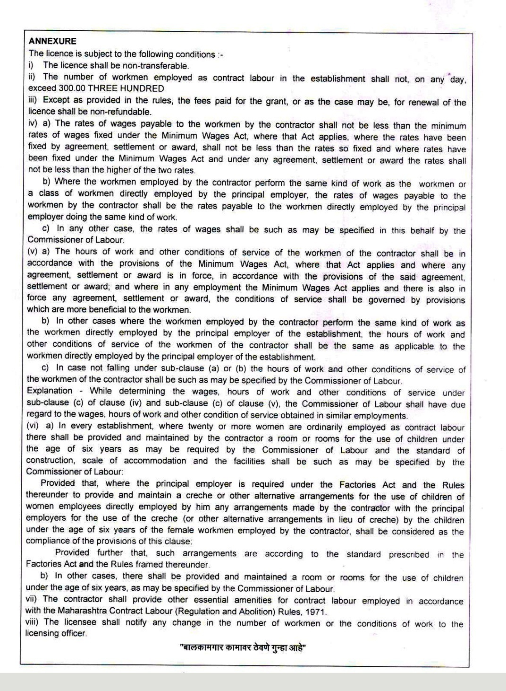
Labour Licence

Slide 37
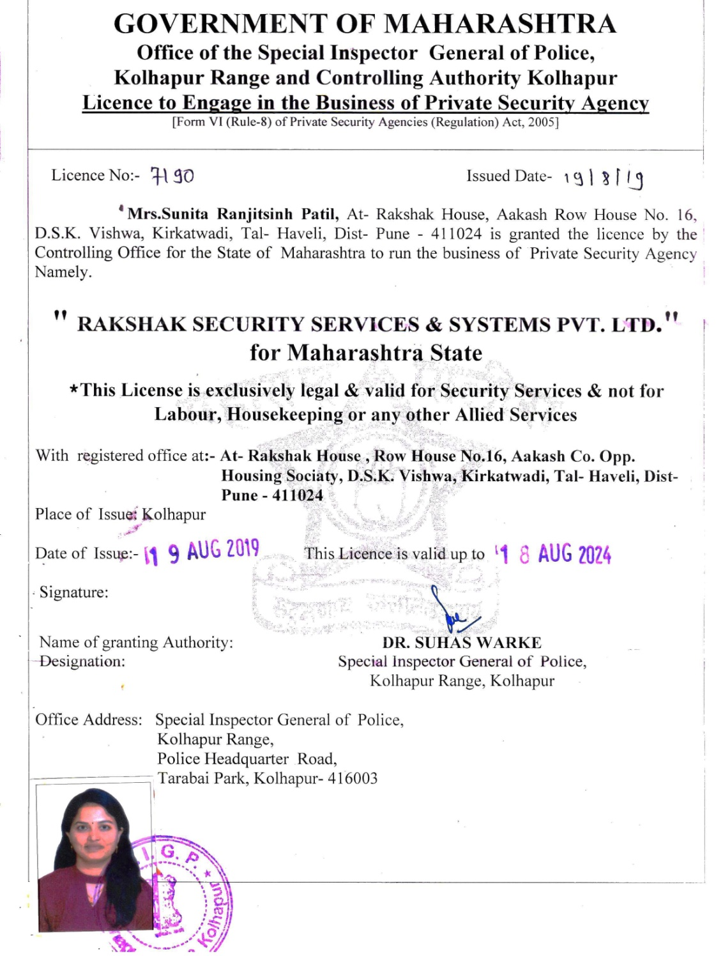
PASARA

Slide 38
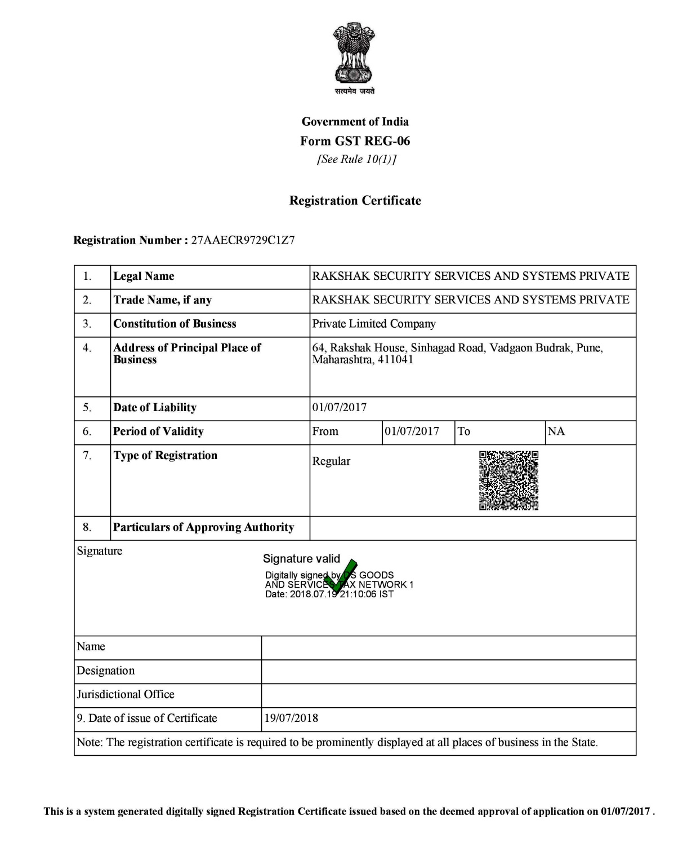
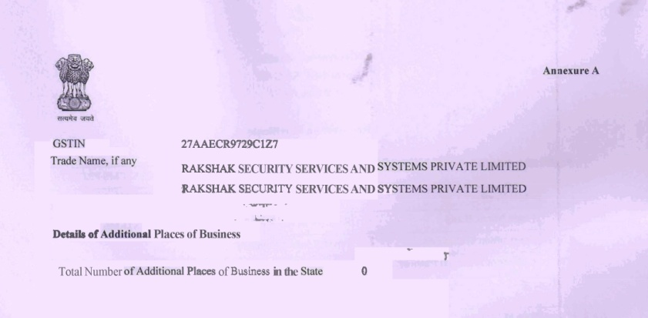
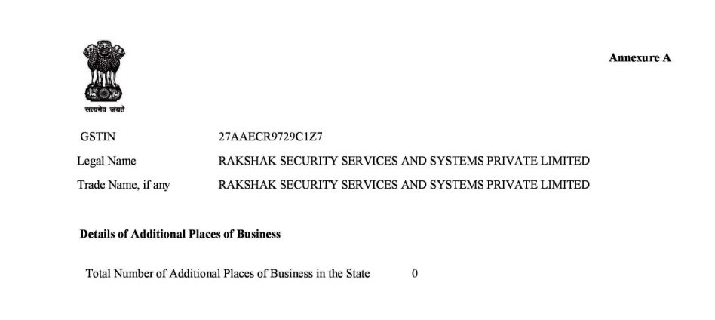
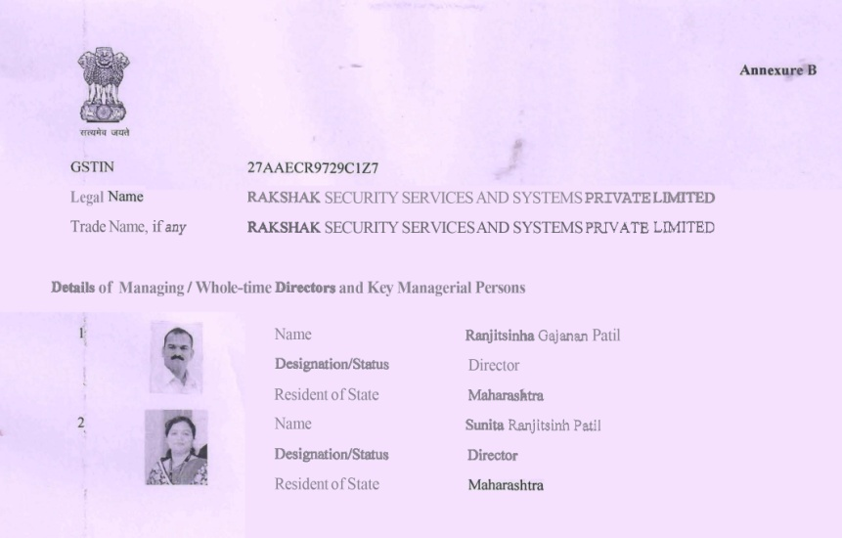
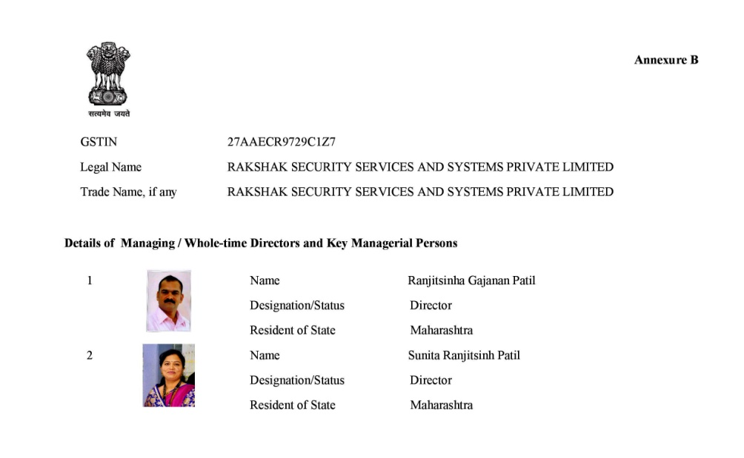
GST Certificate

Slide 39
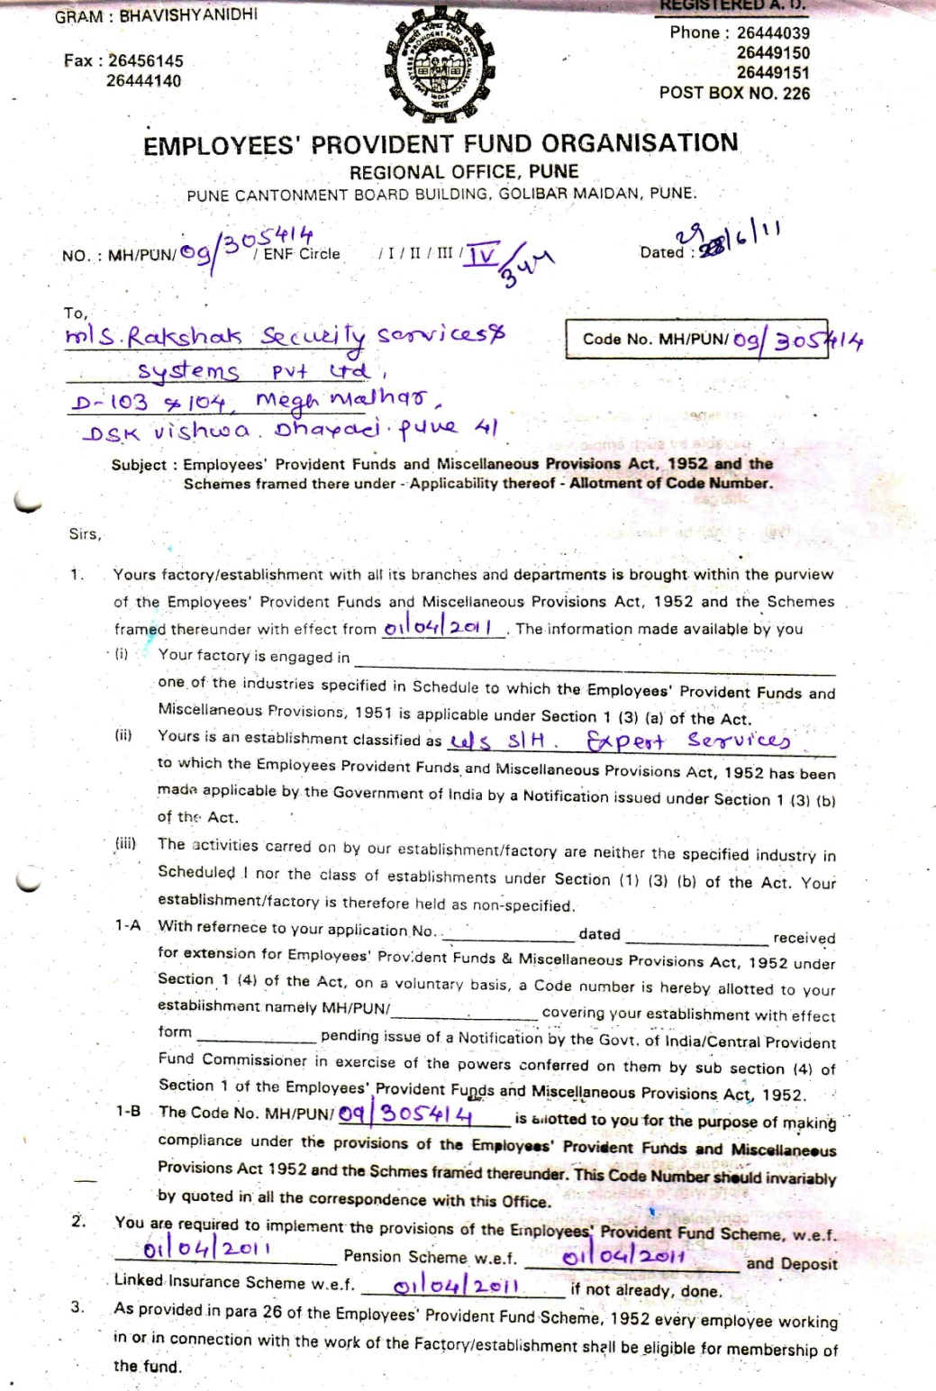
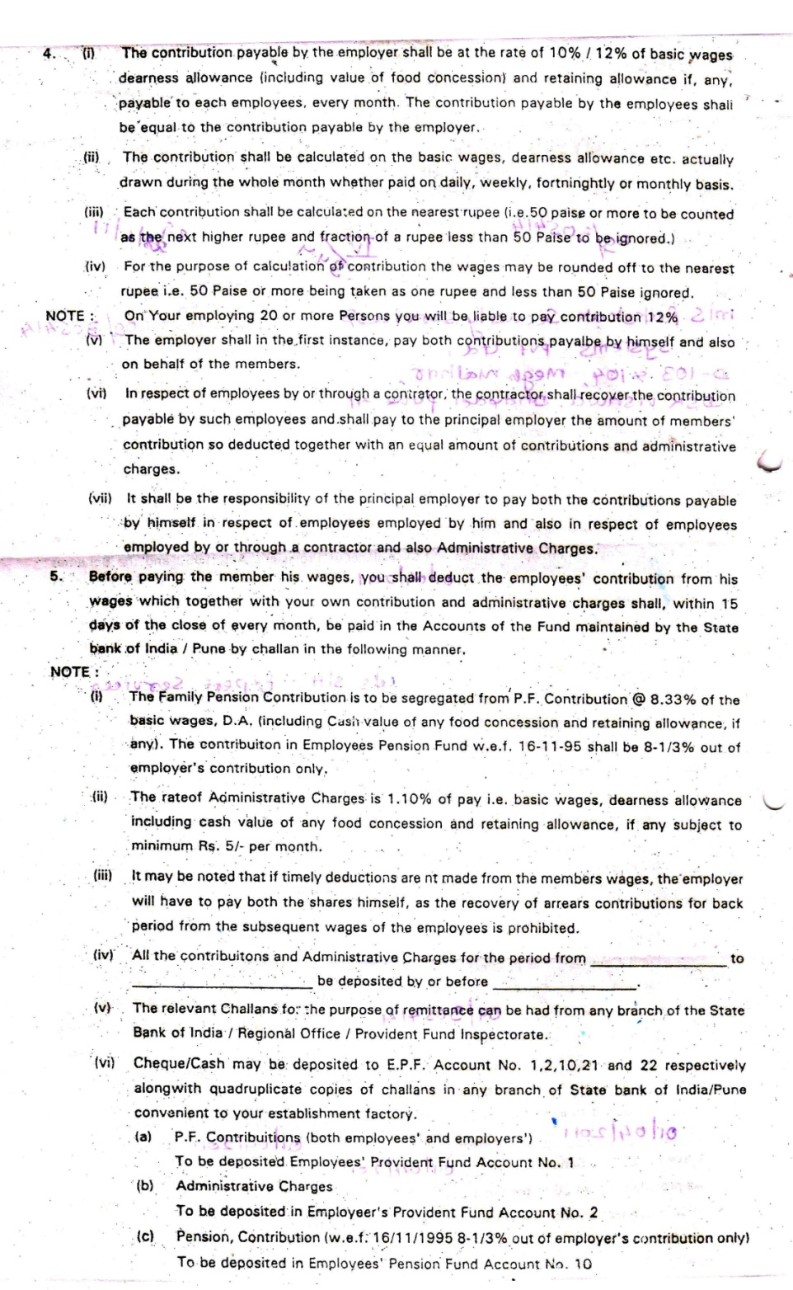
PF

Slide 40
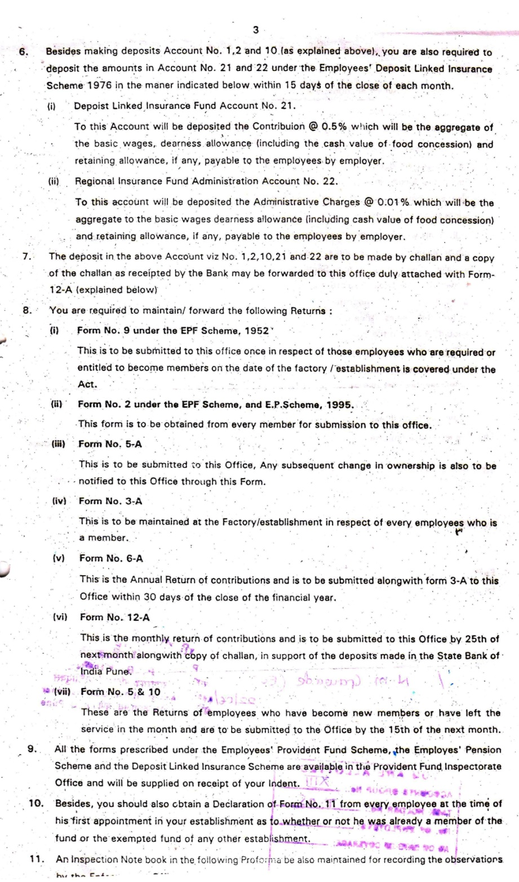
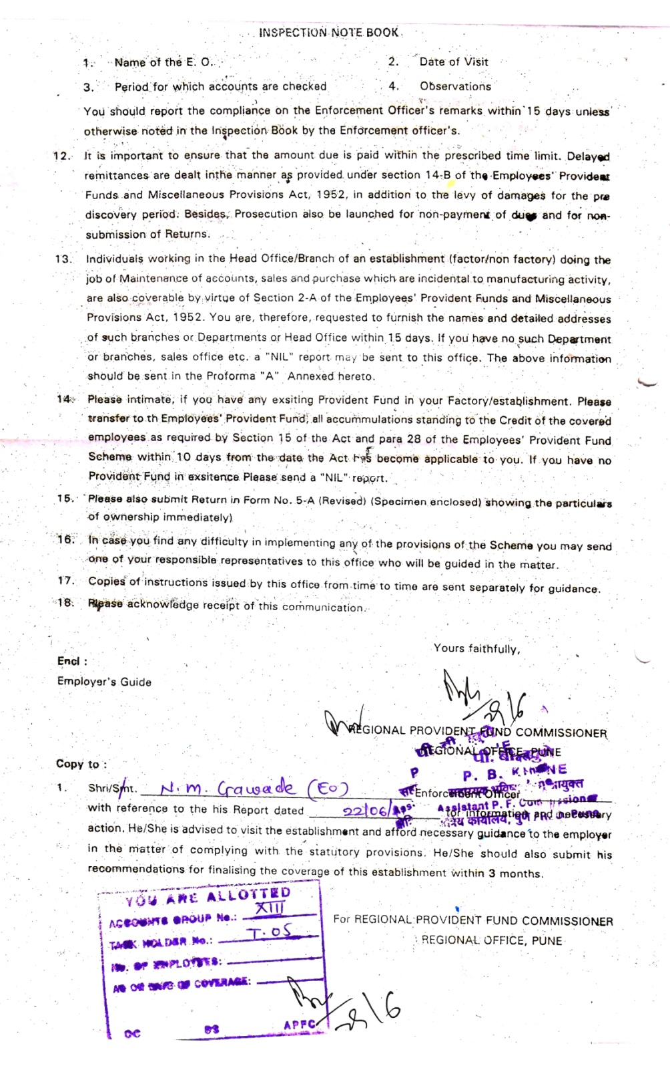
PF

Slide 41
ESIC

Slide 42
TAN

Slide 43
Professional Tax Certificate

Slide 44
Thanks for your time.
Rakshak Security Services & Systems Private Limited
Rakshak House, Sr. No.64/1A/2/1, Wadgaon Budruk, Near Trimurti Hospital, Sinhgad Road, Pune 411041
Tel. Phone. : +02024394141
Email id :rakshakgroup4141@gmail.com
Web:https://www.rakshakgroup.co.in

